Slide 1
MVC & State Machine
May, 2011, Duan Bo

Slide 2



Topic List
Why MVC ?
State Machine
How to use State Machine
    High level
    Special Definition
    Functions in View/Controller/Model
  Q&A
Page. <number>

Slide 3
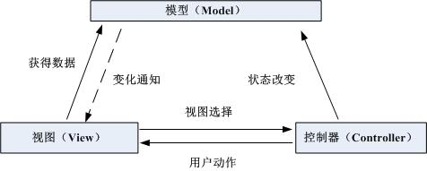
Why MVC?
Low Coupling
Code Sharing
Easy to transplant
Configurable
Let’s see the code in TN 7.0.
Page. <number>

Slide 4
State Machine
In general, a state machine is any device that stores the status of something at a given time and can operate on input to change the status and/or cause an action or output to take place for any given change.
State
Event
Next state
Do something
Let’s see some codes…
Page. <number>

Slide 5
How to use State Machine
Define states/action/event
Compose UI in View
Add logic in Model’s doAction()
If necessary, do controller switch in Controller
Page. <number>

Slide 6
States
Definition:
Transient State
Stable State
Page. <number>

Slide 7
Special State
STATE_ANY
STATE_PREV
STATE_VIRGIN
Page. <number>

Slide 8
Special Command
CMD_COMMON_OK
CMD_COMMON_BACK
CMD_COMMON_CANCEL
CMD_COMMON_EXIT
CMD_COMMON_HOME
Page. <number>

Slide 9
Functions in Model
put(Key, Value)
get(Key) / fetch(Key)
remove(Key)
postModelEvent(event)
release()
Page. <number>

Slide 10
Functions in Controller
init()
activate()
release()
postControllerEvent()
Page. <number>

Slide 11
Functions in View
createScreen() / updateScreen()
createPopup() / updatePopup()
transformCommandDelegate()
preProcessUIEvent()
prepareModelData()
Page. <number>

Slide 12
Q&A
Page. <number>

